Slide 1


Slide 2
Hibernate Overview
Hibernate Architecture
Hibernate Key Components
Hibernate Functions

Slide 3
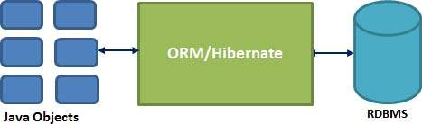
Hibernate Overview
What is Hibernate?
Hibernate is an Object-Relational Mapping(ORM) solution for JAVA.
It is an created by Gavin King in 2001.
Hibernate maps Java classes to database tables and from Java data types to SQL data types

Slide 4
Hibernate Overview
Hibernate Advantages
Hibernate takes care of mapping Java classes to database tables using XML files and without writing any line of code.
Provides simple APIs for storing and retrieving Java objects directly to and from the database.
If there is change in Database or in any table then the only need to change XML file properties.
Abstract away the unfamiliar SQL types and provide us to work around familiar Java Objects.
Hibernate does not require an application server to operate.
Manipulates Complex associations of objects of your database.
Minimize database access with smart fetching strategies.
Provides Simple querying of data.

Slide 5
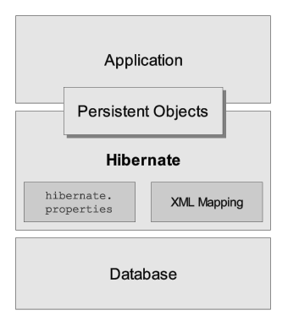
Hibernate Architecture

Slide 6
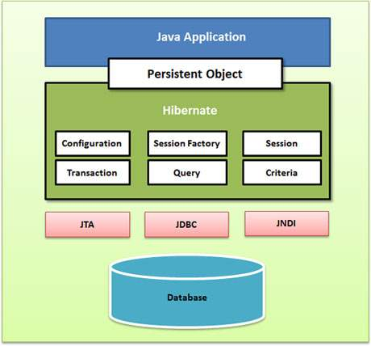
Hibernate Architecture

Slide 7
Hibernate Architecture
Configuration Object
Database Connection: This is handled through one or more configuration files supported by Hibernate. These files are hibernate.properties and hibernate.cfg.xml.
Class Mapping Setup
SessionFactory Object
Created by Configuration object.
Create Session object.
Heavyweight object.

Slide 8
Hibernate Architecture
Session Object
Created by SessionFactory Object.
It is used to get a physical connection with a database.
It is lightweight object.
Transaction Object
Query Object
Query objects use SQL or Hibernate Query Language (HQL) string to retrieve data from the database and create objects.
Query instance is used to bind query parameters, limit the number of results returned by the query, and finally to execute the query.
Criteria Object
Criteria object are used to create and execute object oriented criteria queries to retrieve objects

Slide 9
Hibernate Key Components
Hibernate - Configuration
Hibernate - Sessions
Hibernate - Persistent Class
Hibernate - Mapping Files
Hibernate - Mapping Types

Slide 10
Hibernate - Configuration
hibernate.properties
hibernate.cfg.xml

Slide 11
Hibernate - Configuration
hibernate.cfg.xml example
<?xml version="1.0" encoding="utf-8"?>
<!DOCTYPE hibernate-configuration PUBLIC
"-//Hibernate/Hibernate Configuration DTD 5.0//EN"
"http://hibernate.sourceforge.net/hibernate-configuration-5.0.dtd">
<hibernate-configuration>
<session-factory>
<property name="hibernate.connection.driver_class">
oracle.jdbc.driver.OracleDriver</property>
<property name="hibernate.connection.url">
jdbc:oracle:thin:@localhost:1521:study</property>
<property name="hibernate.connection.username">study</property>
<property name="hibernate.connection.password">password</property>
<property name="hibernate.dialect">
org.hibernate.dialect.Oracle10gDialect</property>
<property name="hibernate.default_schema">study</property>
<property name="show_sql">true</property>
<mapping resource="com/user/DBUser.hbm.xml"></mapping>
</session-factory>
</hibernate-configuration>

Slide 12
Hibernate Configuration Properties
Properties | Description
hibernate.dialect | This property makes Hibernate generate the appropriate SQL for the chosen database.
hibernate.connection.driver_class | The JDBC driver class.
hibernate.connection.url | The JDBC URL to the database instance.
hibernate.connection.username | The database username.
hibernate.connection.password | The database password.
hibernate.connection.pool_size | Limits the number of connections waiting in the Hibernate database connection pool.
hibernate.connection.autocommit | Allows autocommit mode to be used for the JDBC connection.

Slide 13
Hibernate - Sessions
A Session is used to get a physical connection with a database.
The main function of the Session is to offer create, read and delete operations for instances of mapped entity classes.
Session object is created by SessionFactory
Session session = factory.openSession();
Transaction tx = null;
try {
tx = session.beginTransaction();
// do some work
...
tx.commit();
} catch (Exception e) {
if (tx!=null) tx.rollback();
e.printStackTrace();
} finally {
session.close();
}

Slide 14
Hibernate - Sessions
Session Methods | Description
Transaction beginTransaction() | Begin a unit of work and return the associated Transaction object.
Transaction getTransaction() | Get the Transaction instance associated with this session.
Connection close() | End the session by releasing the JDBC connection and cleaning up.
Criteria createCriteria(Class persistentClass) | Create a new Criteria instance, for the given entity class, or a superclass of an entity class.
Criteria createCriteria(String entityName) | Create a new Criteria instance, for the given entity name.
Query createQuery(String queryString) | Create a new instance of Query for the given HQL query string.
Serializable save(Object object) | Persist the given transient instance, first assigning a generated identifier.
void update(Object object) | Update the persistent instance with the identifier of the given detached instance.
…… | …….

Slide 15
Hibernate - Persistent Class
Java classes whose objects or instances will be stored in database tables are called persistent classes in Hibernate.
Main rules of persistent classes:

Slide 16
Hibernate - Persistent Class
All Java classes that will be persisted need a default constructor.
All classes should contain an ID in order to allow easy identification of your objects within Hibernate and the database. This property maps to the primary key column of a database table.
All attributes that will be persisted should be declared private and have getXXX and setXXX methods defined in the JavaBean style.
A central feature of Hibernate, proxies, depends upon the persistent class being either non-final, or the implementation of an interface that declares all public methods.
All classes that do not extend or implement some specialized classes and interfaces required by the EJB framework.

Slide 17
Hibernate - Persistent Class
public class DBUser implements java.io.Serializable {
private static final long serialVersionUID = 1L;
private int userId;
private String username;
private String createdBy;
private Date createdDate;
public DBUser() {
}
public DBUser(int userId, String username, String createdBy,Date createdDate) {
this.userId = userId;
this.username = username;
this.createdBy = createdBy;
this.createdDate = createdDate;
}
public int getUserId() {
return this.userId;
}
public void setUserId(int userId) {
this.userId = userId;
}
…..

Slide 18
Hibernate - Mapping Files
Hibernate Object/relational mappings are defined in an XML document or directly in Persistent Class.
The XML mapping document should be saved in a file with the format <classname>.hbm.xml.
Example:
CREATE TABLE DBUSER (
USER_ID NUMBER (5) NOT NULL,
USERNAME VARCHAR2 (20) NOT NULL,
CREATED_BY VARCHAR2 (20) NOT NULL,
CREATED_DATE DATE NOT NULL,
PRIMARY KEY ( USER_ID )
)

Slide 19
Hibernate - Mapping Files
<?xml version="1.0"?>
<!DOCTYPE hibernate-mapping PUBLIC "-//Hibernate/Hibernate Mapping DTD 5.0//EN"
"http://hibernate.sourceforge.net/hibernate-mapping-5.0.dtd">
<hibernate-mapping>
<class name="com.user.DBUser" table="DBUSER">
<id name="userId" type="int">
<column name="USER_ID" precision="5" scale="0" />
<generator class="assigned" />
</id>
<property name="username" type="string">
<column name="USERNAME" length="20" not-null="true" />
</property>
<property name="createdBy" type="string">
<column name="CREATED_BY" length="20" not-null="true" />
</property>
<property name="createdDate" type="date">
<column name="CREATED_DATE" length="7" not-null="true" />
</property>
</class>
</hibernate-mapping>

Slide 20
Hibernate - Mapping Files
@Entity
@Table(name = "DBUSER")
public class DBUser implements java.io.Serializable {
private int userId;
private String username;
private String createdBy;
private Date createdDate;
public DBUser() {
}
public DBUser(int userId, String username, String createdBy,Date createdDate) {
this.userId = userId;
this.username = username;
this.createdBy = createdBy;
this.createdDate = createdDate;
}
@Id
@Column(name = "USER_ID", unique = true, nullable = false, precision = 5, scale = 0)
public int getUserId() {
return this.userId;
}
public void setUserId(int userId) {
this.userId = userId;
}
@Column(name = "USERNAME", nullable = false, length = 20)
public String getUsername() {
return this.username;
}
public void setUsername(String username) {
this.username = username;
}

Slide 21
Hibernate - Mapping Types
We have declared type to mapping Java data types into RDBMS data types.
But the types are not Java data types; they are not SQL database types either.
These types are called Hibernate mapping types, which can translate from Java to SQL data types and vice versa.
Below is Primitive types

Slide 22
Hibernate - Mapping Types
Mapping type | Java type | ANSI SQL Type
integer | int or java.lang.Integer | INTEGER
long | long or java.lang.Long | BIGINT
short | short or java.lang.Short | SMALLINT
float | float or java.lang.Float | FLOAT
double | double or java.lang.Double | DOUBLE
big_decimal | java.math.BigDecimal | NUMERIC
character | java.lang.String | CHAR(1)
string | java.lang.String | VARCHAR
byte | byte or java.lang.Byte | TINYINT
boolean | boolean or java.lang.Boolean | BIT
yes/no | boolean or java.lang.Boolean | CHAR(1) ('Y' or 'N')
true/false | boolean or java.lang.Boolean | CHAR(1) ('T' or 'F')

Slide 23
Hibernate Functions
Hibernate O/R Mappings
Hibernate Query Language
Hibernate Criteria Query
Native SQL in Hibernate
Hibernate Cascade
Hibernate Named Query

Slide 24
Hibernate O/R Mappings
Hibernate Association(Table Relationship).
Types of Relationship:
One-to-one
One-to-many
Many-to-one
Many-to-many

Slide 25
One-to-One Mapping
One-to-one: A one-to-one relationships occurs when one entity is related to exactly one occurrence in another entity.
Example:

Slide 26
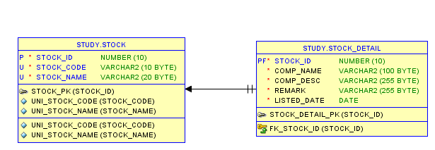
One-to-One Mapping
We have 2 tables which have one-to-one relationship.

Slide 27
One-to-One Mapping
CREATE TABLE "STUDY"."STOCK"
("STOCK_ID" NUMBER(10,0),
"STOCK_CODE" VARCHAR2(10 BYTE) NOT NULL,
"STOCK_NAME" VARCHAR2(20 BYTE) NOT NULL,
PRIMARY KEY (STOCK_ID),
CONSTRAINT UNI_STOCK_CODE UNIQUE (STOCK_CODE),
CONSTRAINT UNI_STOCK_NAME UNIQUE (STOCK_NAME)
);
CREATE TABLE "STUDY"."STOCK_DETAIL"
(
"STOCK_ID" NUMBER(10,0) NOT NULL ,
"COMP_NAME" varchar(100) NOT NULL,
"COMP_DESC" varchar(255) NOT NULL,
"REMARK" varchar(255) NOT NULL,
"LISTED_DATE" date NOT NULL,
PRIMARY KEY (STOCK_ID) ,
CONSTRAINT FK_STOCK_ID FOREIGN KEY (STOCK_ID) REFERENCES stock (STOCK_ID)
);

Slide 28
One-to-One Mapping
Using XML mapping, we have:
Stock.hbm.xml
StockDetail.hbm.xml
Key note in Stock.hbm.xml:
<one-to-one name="stockDetail" class="com.stock.StockDetail"
cascade="save-update">
</one-to-one>

Slide 29
One-to-One Mapping
Key note in StockDetail.hbm.xml
<id name="stockId" type="java.lang.Integer">
<column name="STOCK_ID" />
<generator class="foreign">
<param name="property">stock</param>
</generator>
</id>
……
<one-to-one name="stock" lass="com.stock.Stock" constrained="true">
</one-to-one>

Slide 30
One-to-Many Mapping
One-to-Many: A one-to-many relationship occurs when one entity is related to many occurrences in another entity.
Example:

Slide 31
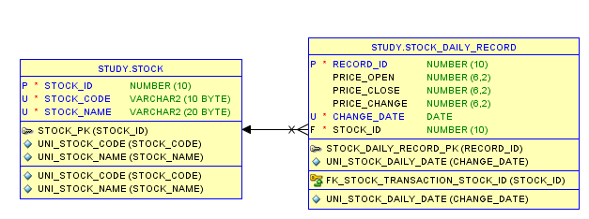
One-to-Many Mapping
We have 2 tables which have one-to-many relationship.

Slide 32
One-to-Many Mapping
CREATE TABLE "STUDY"."STOCK"
("STOCK_ID" NUMBER(10,0),
"STOCK_CODE" VARCHAR2(10 BYTE) NOT NULL,
"STOCK_NAME" VARCHAR2(20 BYTE) NOT NULL,
PRIMARY KEY (STOCK_ID),
CONSTRAINT UNI_STOCK_CODE UNIQUE (STOCK_CODE),
CONSTRAINT UNI_STOCK_NAME UNIQUE (STOCK_NAME)
);
CREATE TABLE "STUDY"."STOCK_DAILY_RECORD" (
"RECORD_ID" NUMBER(10,0),
"PRICE_OPEN" NUMBER(6,2) DEFAULT NULL,
"PRICE_CLOSE" NUMBER(6,2) DEFAULT NULL,
"PRICE_CHANGE" NUMBER(6,2) DEFAULT NULL,
"VOLUME" NUMBER(20) DEFAULT NULL,
"DATE" date NOT NULL,
"STOCK_ID" NUMBER(10,0) NOT NULL,
PRIMARY KEY ("RECORD_ID"),
CONSTRAINT "UNI_STOCK_DAILY_DATE" UNIQUE ("DATE"),
CONSTRAINT "FK_STOCK_TRANSACTION_STOCK_ID" FOREIGN KEY ("STOCK_ID") REFERENCES "STOCK" ("STOCK_ID") ON DELETE CASCADE
);

Slide 33
One-to-Many Mapping
Using XML mapping, we have:
Stock.hbm.xml
StockDailyRecord.hbm.xml
Key note in Stock.hbm.xml:
<set name="stockDailyRecords" table="STOCK_DAILY_RECORD" inverse="true" lazy="true" fetch="select">
<key>
<column name="STOCK_ID" precision="10" scale="0"
not-null="true" />
</key>
<one-to-many class="com.stock.StockDailyRecord" />
</set>

Slide 34
One-to-Many Mapping
Key note in StockDailyRecord.hbm.xml
<many-to-one name="stock" class="com.stock.Stock" fetch="select">
<column name="STOCK_ID" precision="10" scale="0" not-null="true"/>
</many-to-one>

Slide 35
Many-to-Many Mapping
Many-to-Many: Many-to-many relationships occur when each record in an entity may have many linked records in another entity and vice-versa.
Example:

Slide 36
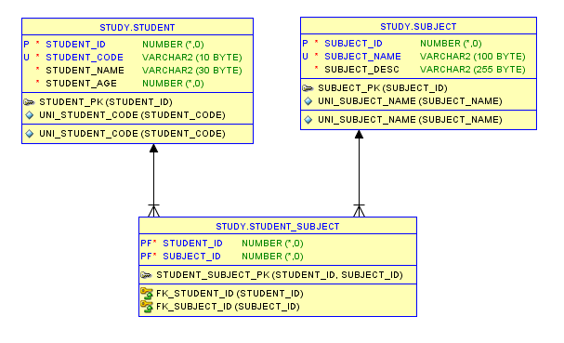
Many-to-Many Mapping
We have 3 tables which have many-to-many relationship.

Slide 37
Many-to-Many Mapping
Using XML mapping, we have:
Student.hbm.xml
Subject.hbm.xml
Key note in Student.hbm.xml:
<set name="subjects" table="STUDENT_SUBJECT" inverse="false" lazy="true" fetch="select" cascade="all">
<key>
<column name="STUDENT_ID" precision="22" scale="0" not-null="true" />
</key>
<many-to-many entity-name="com.student.Subject">
<column name="SUBJECT_ID" precision="22" scale="0"
not-null="true"/>
</many-to-many>
</set>

Slide 38
Many-to-Many Mapping
Key note in Subject.hbm.xml
<set name="students" table="STUDENT_SUBJECT" inverse="true" lazy="true" fetch="select">
<key>
<column name="SUBJECT_ID" precision="22" scale="0" not-null="true" />
</key>
<many-to-many entity- name="com.student.Student">
<column name="STUDENT_ID" precision="22" scale="0" not-null="true" />
</many-to-many>
</set>

Slide 39
Hibernate Query Language
Hibernate created a new language named Hibernate Query Language (HQL), the syntax is quite similar to database SQL language.
The main difference between is HQL uses class name instead of table name, and property names instead of column name.
HQL queries are translated by Hibernate into conventional SQL queries which in turns perform action on database.

Slide 40
Hibernate Query Language
HQL Select Query Example
String hql = “SELECT E.* FROM Employee E WHERE E.id > 10 AND E.name :=name ORDER BY E.firstName DESC, E.salary DESC ";
Query query = session.createQuery(hql);
List results = query.list();
HQL Update Query Example
String hql = "UPDATE Employee set salary = :salary WHERE id = :employee_id";
Query query = session.createQuery(hql);
query.setParameter("salary", 1000);
query.setParameter("employee_id", 10);
int result = query.executeUpdate();

Slide 41
Hibernate Query Language
HQL Delete Query Example
String hql = "DELETE FROM Employee WHERE id = :employee_id";
Query query = session.createQuery(hql);
query.setParameter("employee_id", 10);
int result = query.executeUpdate();
HQL Insert Query Example
String hql = "INSERT INTO Employee(firstName, lastName, salary) SELECT firstName, lastName, salary FROM old_employee";
Query query = session.createQuery(hql);
int result = query.executeUpdate();

Slide 42
Hibernate Criteria Query
Hibernate Criteria API is a more object oriented and elegant alternative to Hibernate Query Language (HQL).
It help developer build an query which has many optional search criteria easier and programmatically.
Criteria object is created by createCriteria() method of The Hibernate Session interface
Criteria criteria = session.createCriteria(Stock.class);

Slide 43
Hibernate Criteria Query
Example
public static List getStockDailyRecordCriteria(Date startDate,Date endDate, Long volume,Session session){
Criteria criteria = session.createCriteria(StockDailyRecord.class);
if(startDate!=null){
criteria.add(Expression.ge("date",startDate));
}
if(endDate!=null){
criteria.add(Expression.le("date",endDate));
}
if(volume!=null){
criteria.add(Expression.ge("volume",volume));
}
criteria.addOrder(Order.asc("date"));
return criteria.list();
}

Slide 44
Native SQL in Hibernate
Beside HQL, Hibernate also supports you write your own SQL(native SQL).
Native SQL help you utilize database-specific features such as query hints or the CONNECT keyword in Oracle.
Native SQL query from is created with the createSQLQuery() method on the Session interface.
public SQLQuery createSQLQuery(String sqlString)
throws HibernateException

Slide 45
Native SQL in Hibernate
Scalar(value) queries:
The most basic SQL query is to get a list of scalars (values) from one or more tables.
Example:
Query query = session.createSQLQuery(
"select s.stock_code,s.stock_name from stock s where s.stock_code = :stockCode");
query.setParameter("stockCode", "7277");
List result = query.list();

Slide 46
Native SQL in Hibernate
Entity queries:
Below example, we tell Hibernate to return you a Stock.class, all the select data (*) will match to your Stock.class properties automatically
Example:
SQLQuery query = session.createSQLQuery(
"select * from stock s where s.stock_code = :stockCode");
query.addEntity(Stock.class);
query.setParameter("stockCode","7277");
List result = query.list();

Slide 47
Hibernate Named Query
Named Query lets developers put the HQL into XML mapping file or annotation for maintainability purpose.
Example

Slide 48
Hibernate Named Query
XML mapping file
<!-- stock.hbm.xml -->
<hibernate-mapping>
<class name="com.stock.Stock" table="stock" ...>
<id name="stockId" type="java.lang.Integer">
<column name="STOCK_ID" />
<generator class="native"/>
</id>
...
</class>
<!--This is HQL -->
<query name="findStockByStockCode">
<![CDATA[from Stock s where s.stockCode = :stockCode]]>
</query>
<!--This is Native SQL-->
<sql-query name="findStockByStockCodeNativeSQL">
<return alias="stock" class="com.stock.Stock"/>
<![CDATA[select * from stock s where s.stock_code = :stockCode]]>
</sql-query>
</hibernate-mapping>

Slide 49
Hibernate Named Query
Annotation
HQL
@NamedQueries({
@NamedQuery(name = "findStockByStockCode",
query = "from Stock s where s.stockCode = :stockCode"
)
})
@Entity
@Table(name = "stock")
public class Stock implements java.io.Serializable {…

Slide 50
Hibernate Named Query
Annotation
Native SQL
@NamedNativeQueries({
@NamedNativeQuery(
name = "findStockByStockCodeNativeSQL",
query = "select * from stock s where s.stock_code = :stockCode",
resultClass = Stock.class
)
})
@Entity
@Table(name = "stock")
public class Stock implements java.io.Serializable {..

Slide 51
Hibernate Named Query
Call a named query using getNamedQuery() of Hibernate Session
Query query = session.getNamedQuery("findStockByStockCode");
query.setString("stockCode", "7277");
Query query = session.getNamedQuery(
"findStockByStockCodeNativeSQL");
query.setString("stockCode", "7277");

Slide 52
THANK YOU

